Slide 1
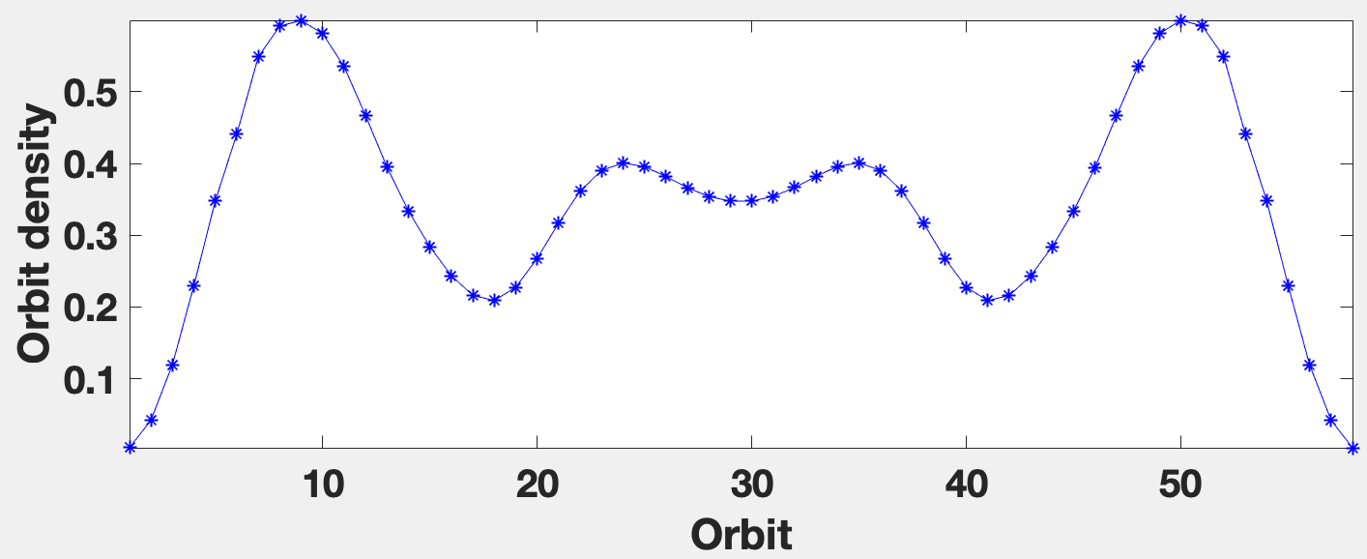
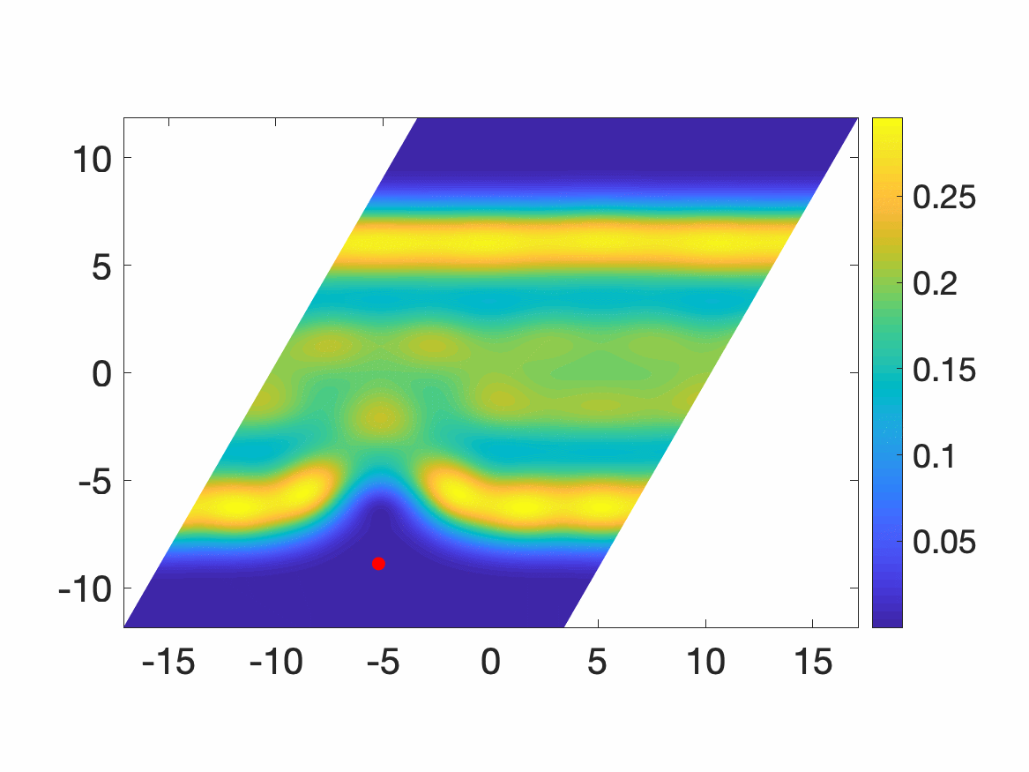
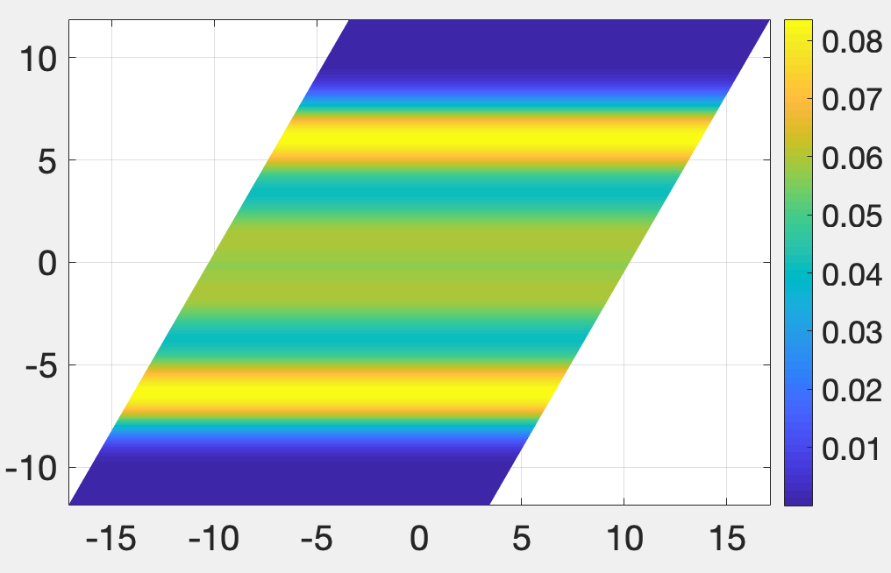
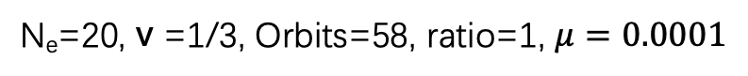
N_{e}=20, v =1/3, Orbits=58, ratio=1, $μ=0.0001$
parallelogram
Pair correlation function
Electron density

Slide 2
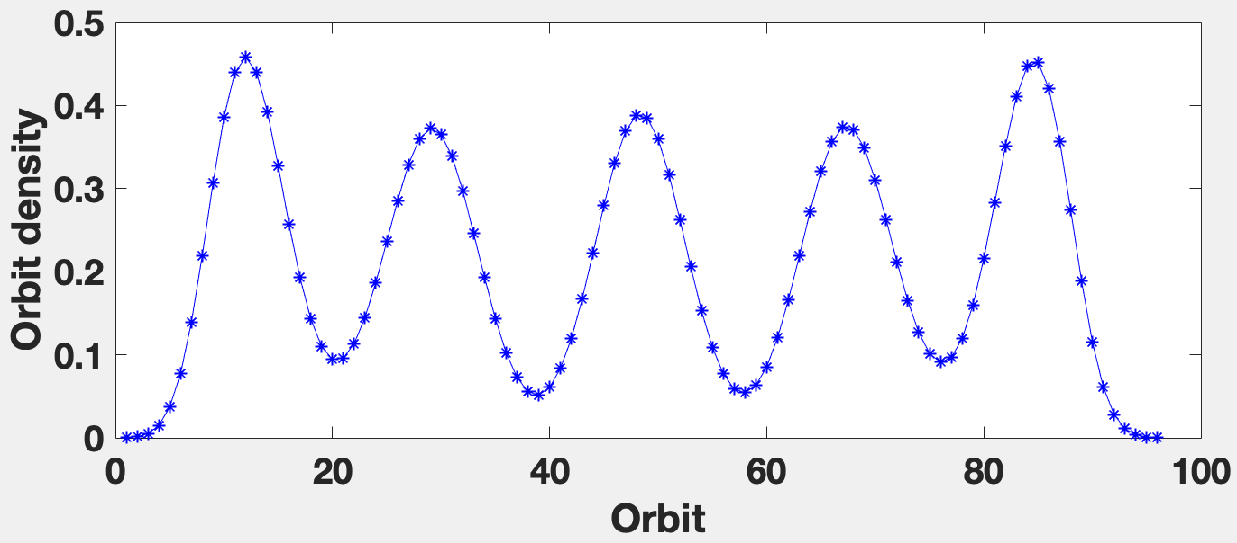
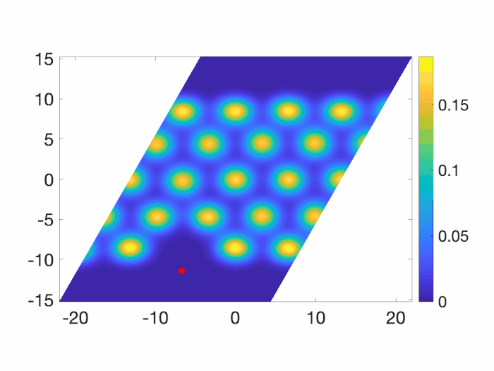
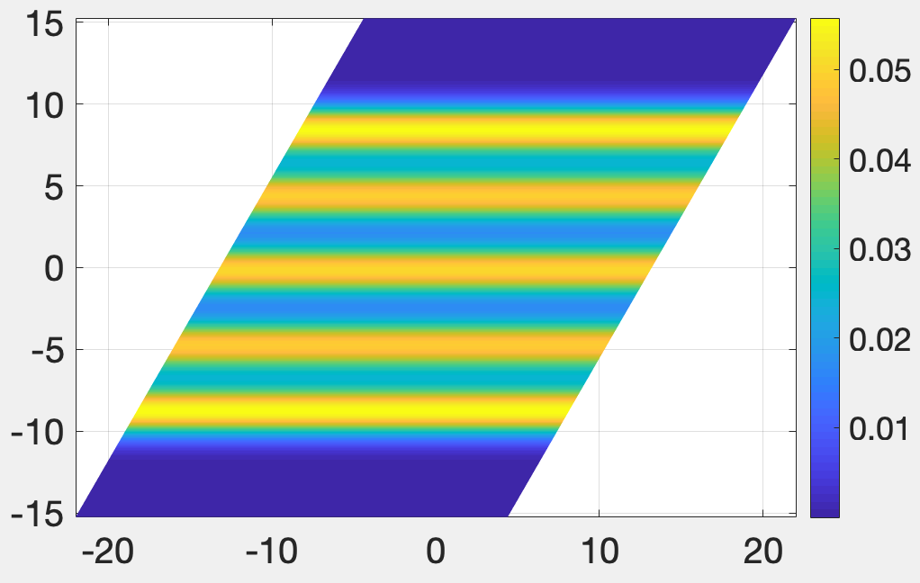
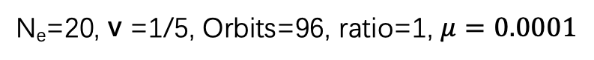
N_{e}=20, v =1/5, Orbits=96, ratio=1, $μ=0.0001$
parallelogram
Pair correlation function
Electron density

Slide 3
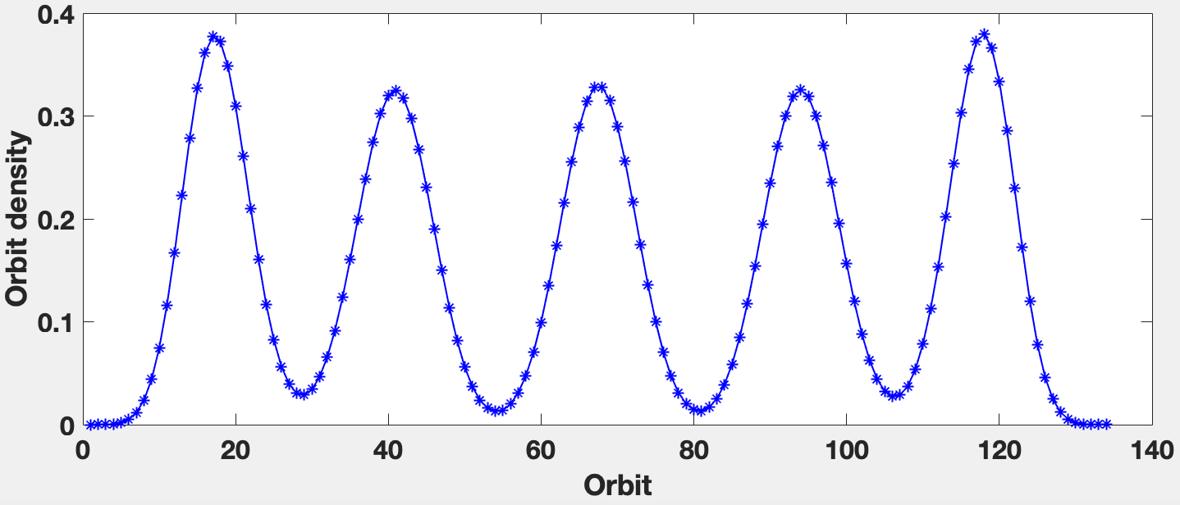
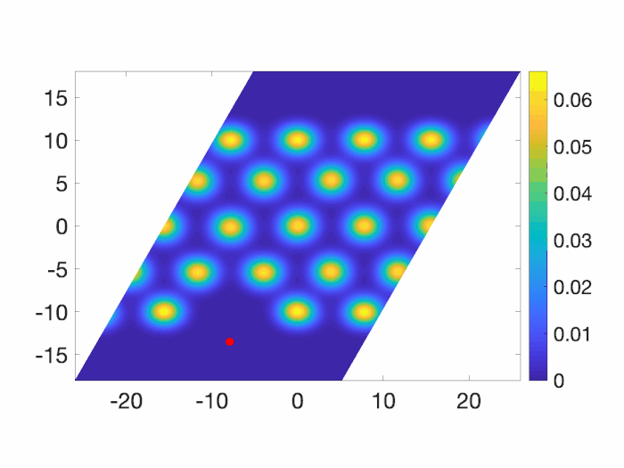
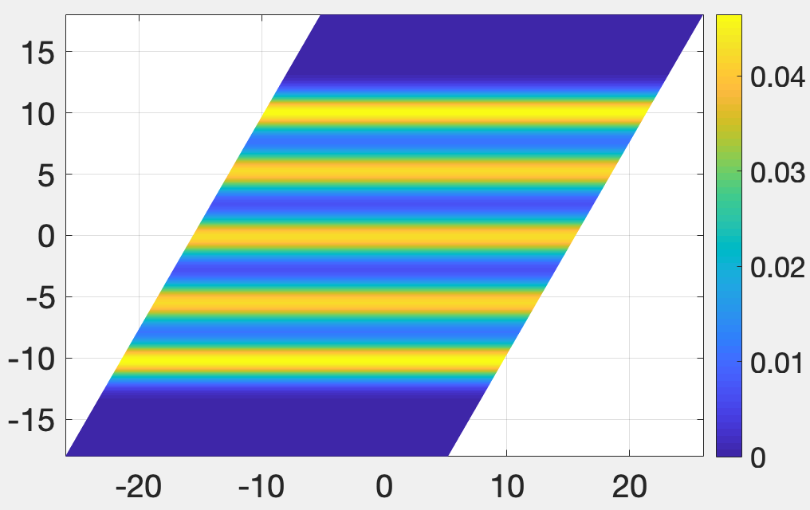
N_{e}=20, v =1/7, Orbits=134, ratio=1, $μ=0.0001$
parallelogram
Pair correlation function
Electron density

Slide 4
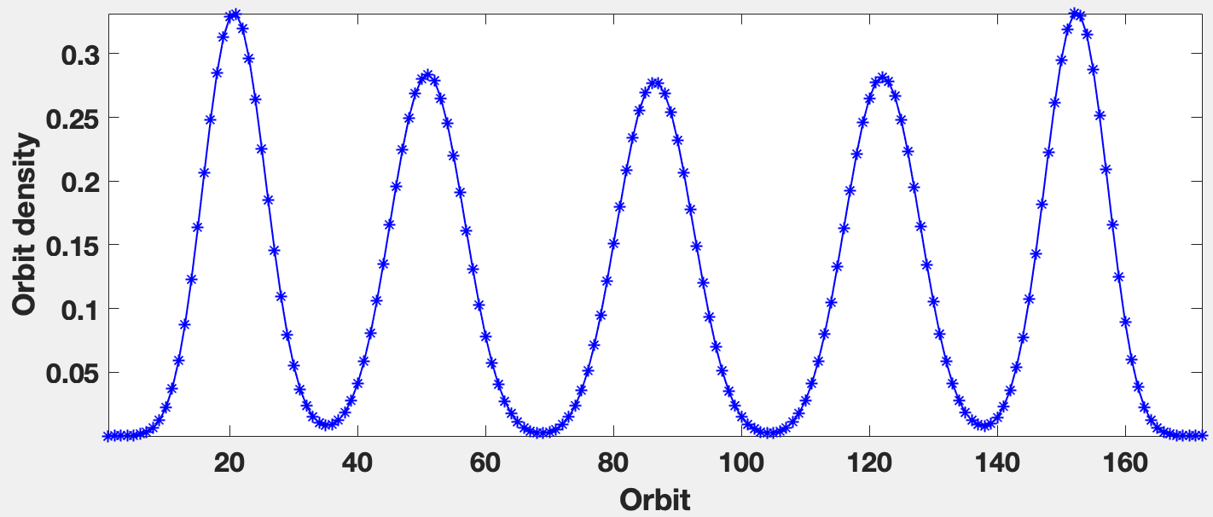
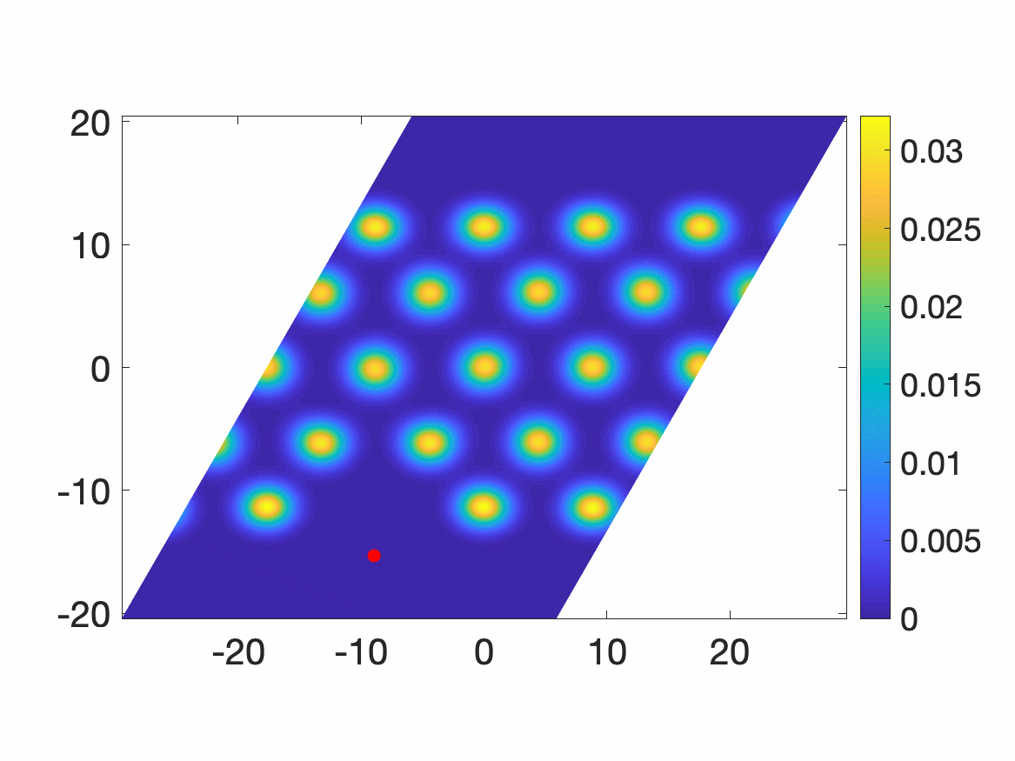
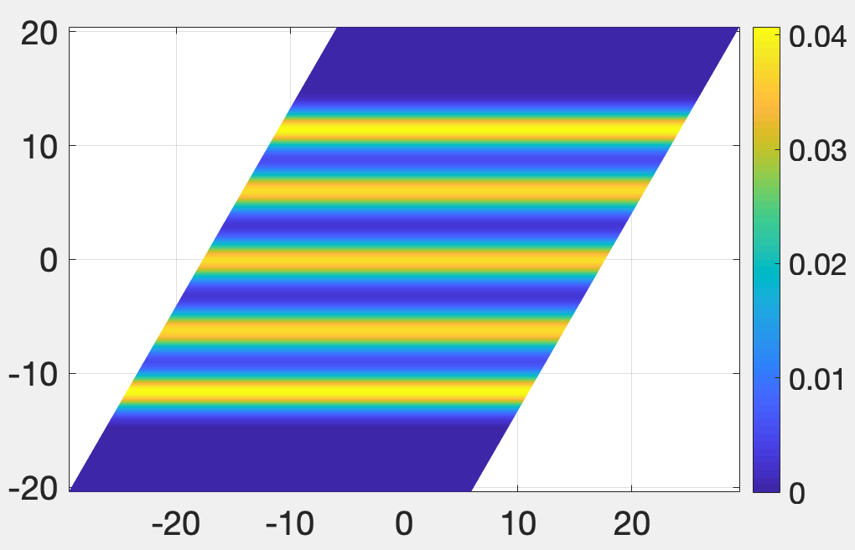
N_{e}=20, v =1/9, Orbits=172, ratio=1, $μ=0.0001$
parallelogram
Pair correlation function
Electron density

